Slide 1
Promotion Mix
Dr Ashumani Bhatia
Faculty,MBA
HIMT, Rohtak

Slide 2
Marketing Communication
Marketing communication is the means by which firms attempt to inform, persuade, and remind consumers, directly or indirectly, about the products and brands they sell.

Slide 3
Communications Process
Message Media
Sender
Encoding
Decoding
Receiver
Noise
Feedback
Response

Slide 4
Elements in Communication Process
Sender- Someone who is sending the message. The maker of the brand is the sender of the advertising message.
Encoding- When we address someone, we use language, visuals, body gestures to communicate. All these are called symbols. The process of putting our thought into symbolic forms is called encoding.
Message- The symbols themselves constitute the message. Hence the visuals, headline, body copy, tag line, brand name, logo all are the parts of the message.
Media- The channel used for sending the message across to the receiver (customer) is called medium (or media).
TV is an audio visual medium Radio is an audio medium

Slide 5
Decoding- Once we receive the message we start interpreting it. The process of giving a meaning to all these symbols is called decoding.
Receiver- A receiver is one who reads/listens/ hears the message of the communicator.
Response- After having read the ad, I will react to the message. My reaction could be objective (if I accept what the sender of the message is saying) or negative (if I don’t accept).
Feedback- Every communicator waits to know whether the message (a)
has reached the target audience or not
(b) whether it has been accepted or not.

Slide 6
Elements of Promotion Mix/Marketing Communication Mix
Evaluation Factor | Advertising | Publicity | Personal Selling | Sales Promotion
1. Objective | To appeal to | To reach masses | To deal with | To stimulate
 | mass audience at | with an | one customer at | sale and to
 | reasonable cost, | independently (i.e | a time to | motivate
 | with an aim to | from a source | answer | individuals to
 | persuade and | other than | questions at | buy on impulse
 | inform | company)
 |  | message
2. Audience | Mass customers | Mass (customers, | Small (one/few) | Mass
 |  | employees,
 |  | stakeholders)
3. Message | Uniform (same | Uniform for one | Specific to each | Generally same
 | for all) | category of | customer
 |  | audience
4. Cost | Low per | No | High per | Depends on
 | audience |  | customer | sales promotion
 |  |  |  | scheme

Slide 7
ELEMENTS OF THE PROMOTION MIX
Advertising - Any paid form of non personal communication of ideas goods or services delivered through selected media channels.
Publicity- It involves sending a message to someone because it is
newsworthy and is published or broadcast without charge to the sender.
Sales Promotion – A range of tactical marketing techniques designed within a strategic marketing framework, to add value to a product or service in order to achieve a specific sales and marketig objective.
Public Relations - The deliberate, planned and sustained effort to establish and maintain mutual understanding between an organisation and its publics".
Selling and Sales Management - The personal interface between a company and its customers, aimed at achieving a sale.
Direct marketing - Direct communication using direct mail, telephone response media and more recently the Internet.

Slide 8
Publicity
Responding to requests from media
Supplying the media with information on events and occurences
Carry the information about the viewpoint of the organisation
Credible message
No media cost
Loss of control of publication
Loss of control of content
Loss of control of timing

Slide 9
Functions of Public Relations
Facilitates company’s overall operations
Aids promotion
Helps in tackling social and environmental issues
Ensures that customers are treated well
Helps in attracting and retaining talented employees
Stakeholders give it benefit of doubt
Develops reputation as a good supplier and customer
Responds effectively to negative publicity

Slide 10
Developing a Sales Promotion campaign
Planning the program
Duration
Incentive to be given
Assessing viability
Pre-testing
Implementing and controlling
Evaluation

Slide 11
Sales Promotion Techniques
Money off
Bonus packs
Free in or on-pack gifts
Free in-the-mail offers
Free samples
Coupons
Competitions
Draws

Slide 12
What is Advertising
It is any paid form of non – personal presentation and promotion of ideas, goods, services by an identified sponsor.

Slide 13
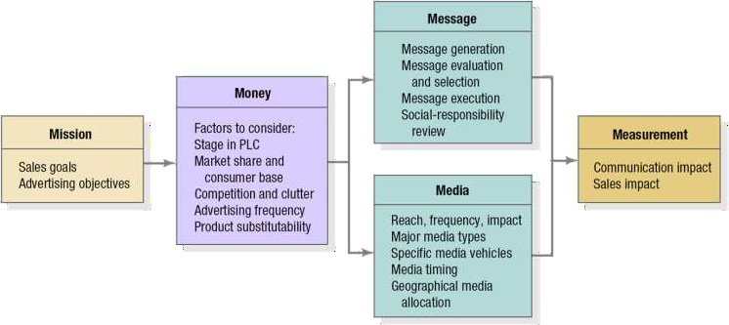
The Five M’s of Advertising

Slide 14
The 5 Ms of Advertising
Mission – objectives
Money – budgets
Message – communication
Media – what vehicles?
Measurement - evaluation

Slide 15
Media Decisions
The most cost effective media mix to ensure achievement of the advertising goal.
Print Media (Newspaper, Magazine)
Electronic Media (Television, Radio, Cinema)
Outdoor Media (Posters, billboards/hoardings)

Slide 16
How should you select media
Reach- No. of persons exposed to a particular media schedule at least once during a specified time period.
Frequency- No. of times within the specified period that a person is exposed to that message.
Impact- Qualitative value of an exposure through a given medium.
TRP

Slide 17
Promotion Mix Strategies
Push strategy
Sales force and trade promotion to push the product through the channels.
Producer promotes product to wholesalers, the wholesalers promote to the retailers and retailers promote to the consumers.
Pull strategy
– Promotion strategy that spends a lot on advertising and consumer promotion to create consumer demand.

Slide 18
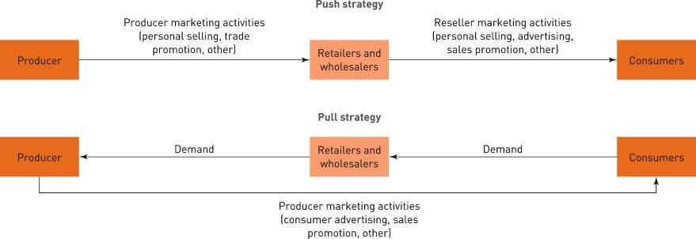
Push versus pull promotion strategy
Push versus pull promotion strategy

Slide 19
What is Direct Marketing
Direct marketing is the use of consumer- direct channels to reach and deliver goods and services to customers without using market middlemen.

Slide 20
Direct Marketing Channels
Direct Mail- Direct mail marketing means sending an offer, announcement, reminder or other item to an individual consumer.
Catalogs
Telemarketing
Other Direct Response- At home shopping channels, Videotext, Kiosks

Slide 21
Online Marketing/ Web Based Marketing
Websites
Microsites
Search ads
Display ads
Internet-specific ads and videos
Sponsorships
Alliances and affiliate programs
Online communities
Email
Mobile marketing

Slide 22
Integrated Marketing Communication
IMC is the development of an Integrated Marketing Communication (Promotion) Plan that links the marketing function with the communication function to deliver Effective Marketing Messages capable of informing, convincing and persuading people to buy.

Slide 23

Integrated Marketing Communications Planning Model
Review of Marketing Plan
Promotional Program Situation Analysis
Analysis of the Communications Process
Budget Determination
Develop Integrated Marketing Communications Programs
Advertising
Sales Promotion
PR/ Publicity
Personal Selling
Direct Marketing
Internet/ Interactive
Advertising Objectives
Sales Promotion Objectives
PR/ Publicity Objectives
Personal Selling Objectives
Direct Marketing Objectives
Internet/ Interactive Objectives
Message Strategy
Sales Promotion Strategy
PR/ Publicity Strategy
Personal Selling Strategy
Direct Marketing Strategy
Internet/ Interactive Strategy
Integration & Implementation of Marketing Communications Strategies
Monitor, Evaluate & Control Promotional Program

Slide 24


























AIDA Model and the Promotion Mix
Awareness
Interest
Desire
Action
Advertising
Very effective
Very effective
Somewhat effective
Not effective
Public Relations
Very effective
Very effective
Very effective
Not effective
Sales Promotion
Somewhat effective
Somewhat effective
Very effective
Very effective
Personal Selling
Somewhat effective
Very effective
Very effective
Somewhat effective

Slide 25









Product Life Cycle and the Promotion Mix
Maturity
Sales ($)
Decline
Introduction
Growth
Time
Light Advertising, pre- introduction Publicity
Heavy use of advertising, PR for awareness; sales promotion for trial
Advertising, PR, Brand loyalty Personal Selling for distribution
Ads decrease. Sales Promotion, Personal Selling Reminder & Persuasive
AD/PR
decrease Limited Sales Promotion, Personal Selling for
distribution

